Slide 1
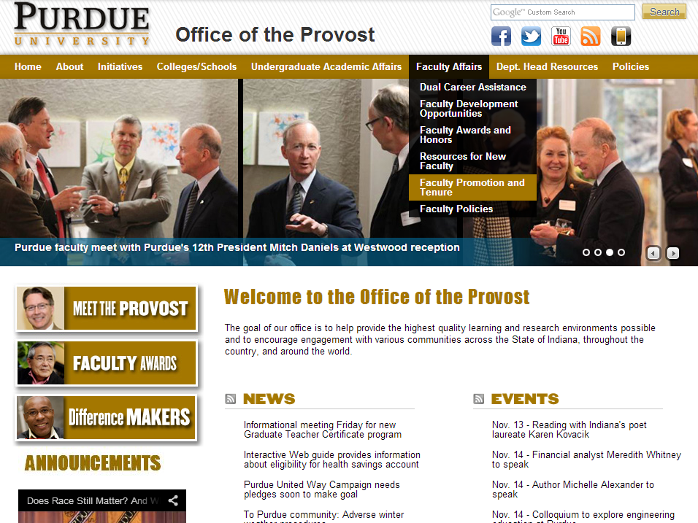

Slide 2
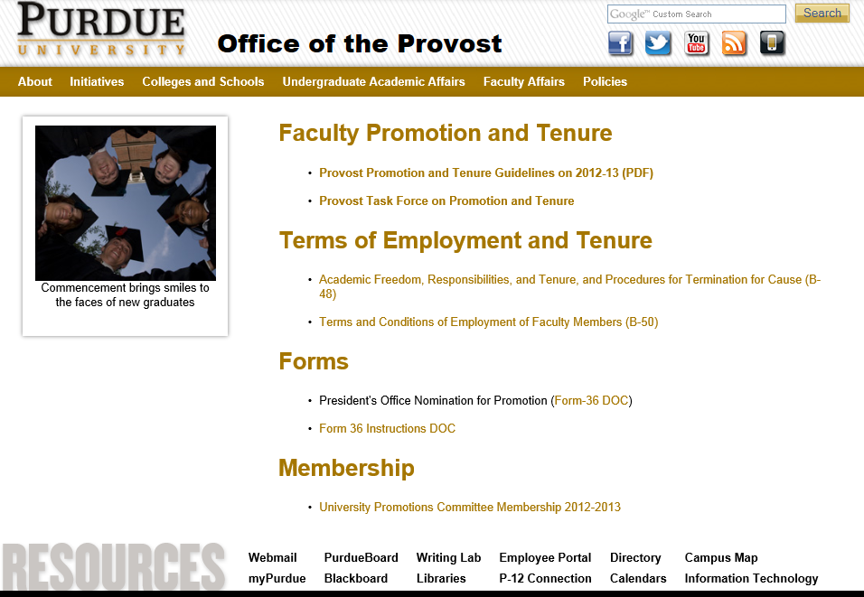
http://www.purdue.edu/provost/faculty/promotion.html

Slide 3
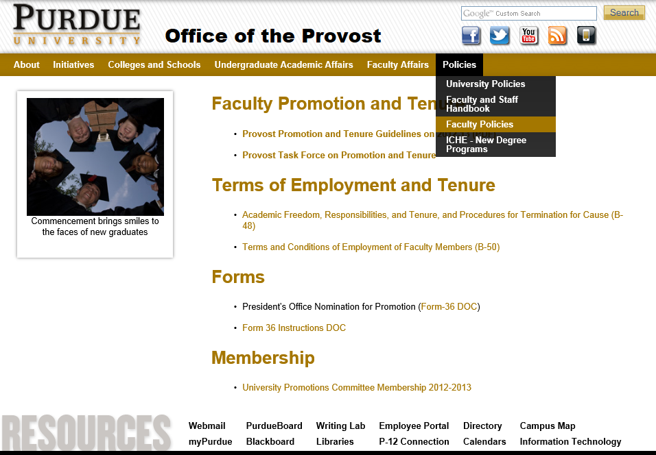
http://www.purdue.edu/provost/faculty/promotion.html

Slide 4
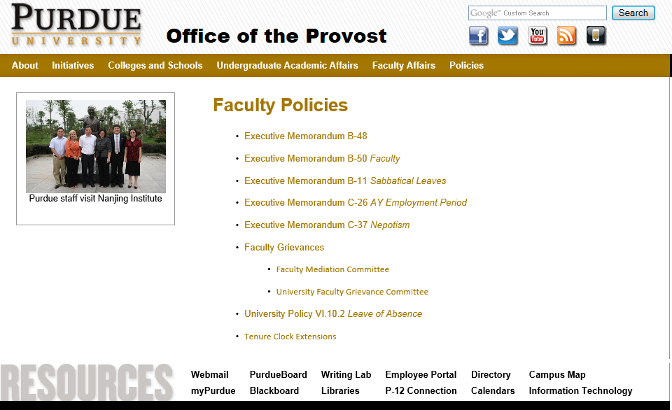
http://www.purdue.edu/provost/faculty/facultypolicies.html

Slide 5

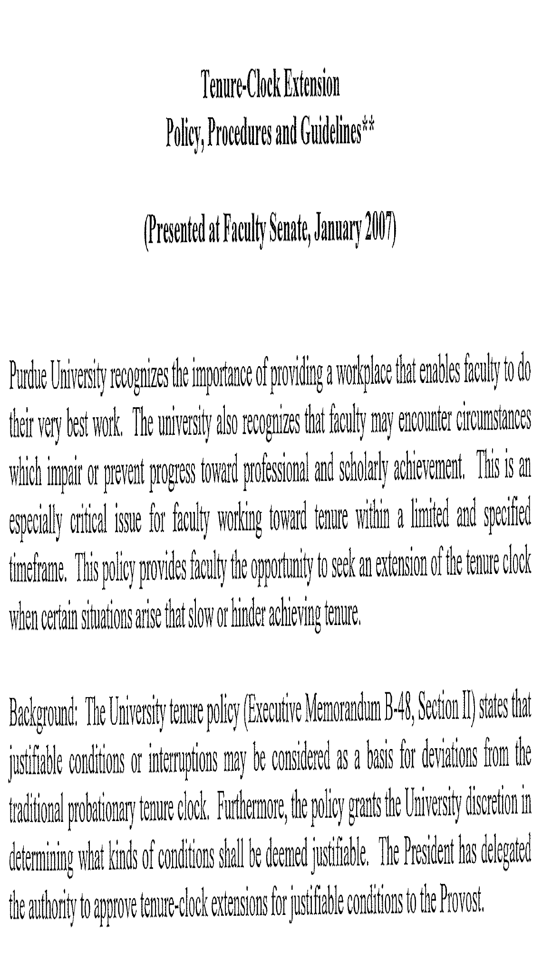

Slide 6
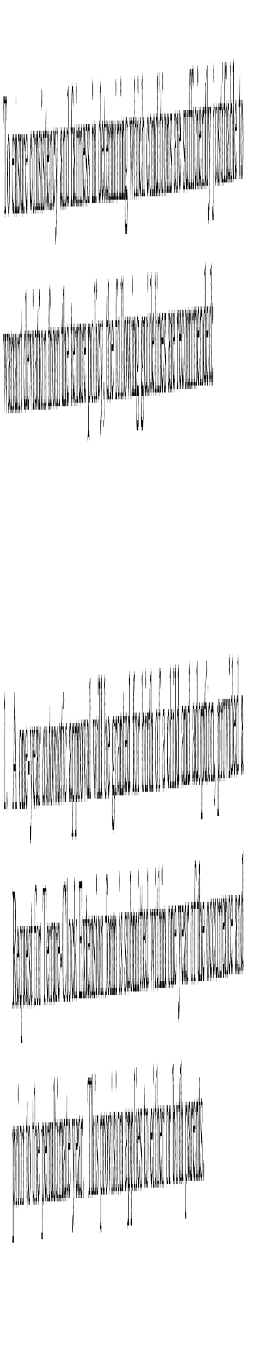

Slide 7
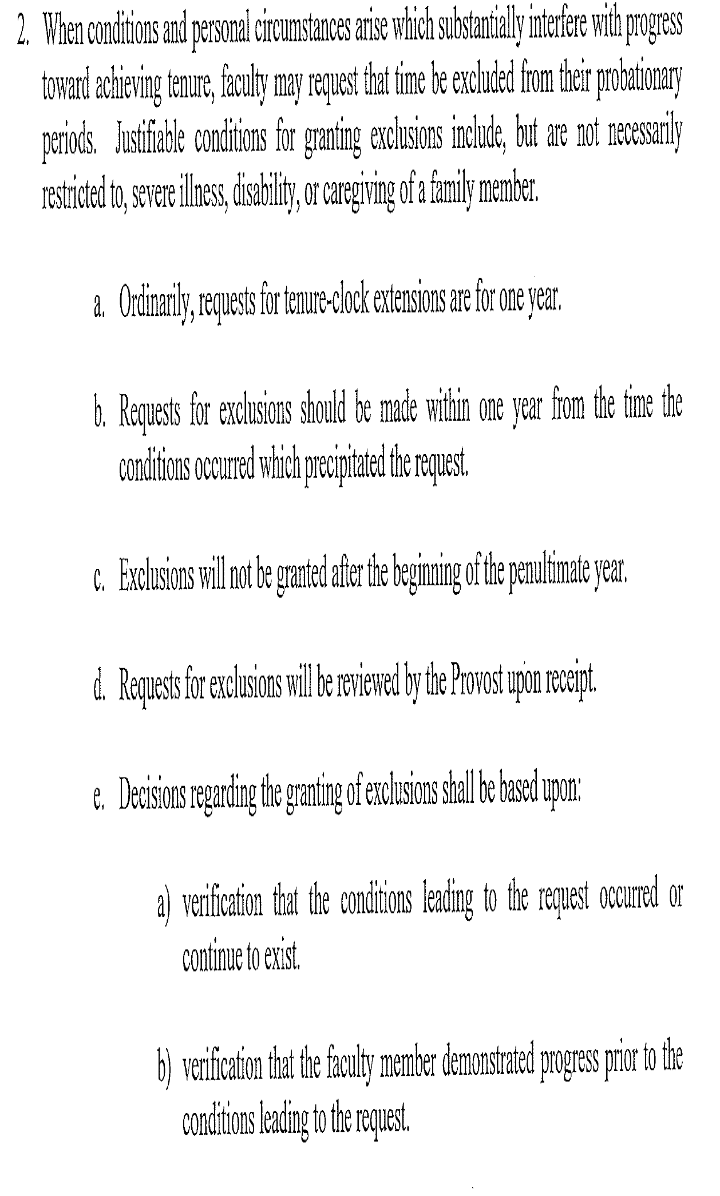

Slide 8
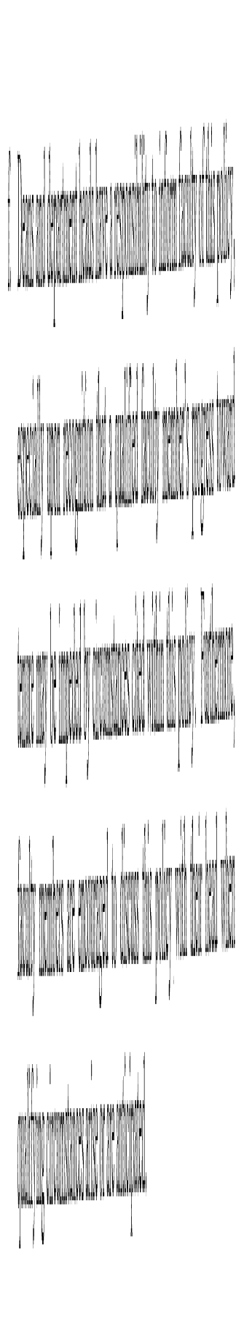

Slide 9
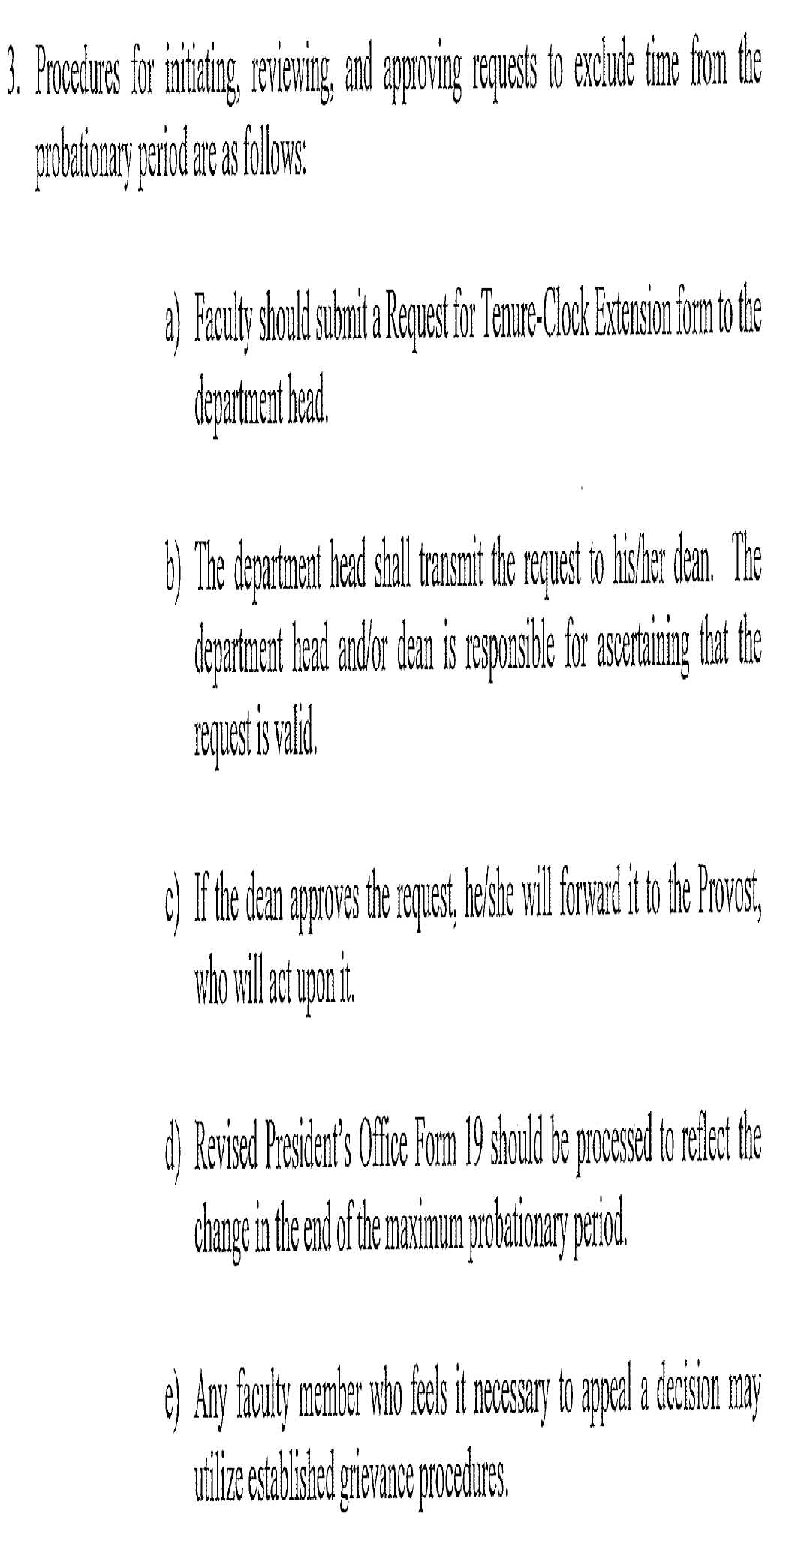

Slide 10
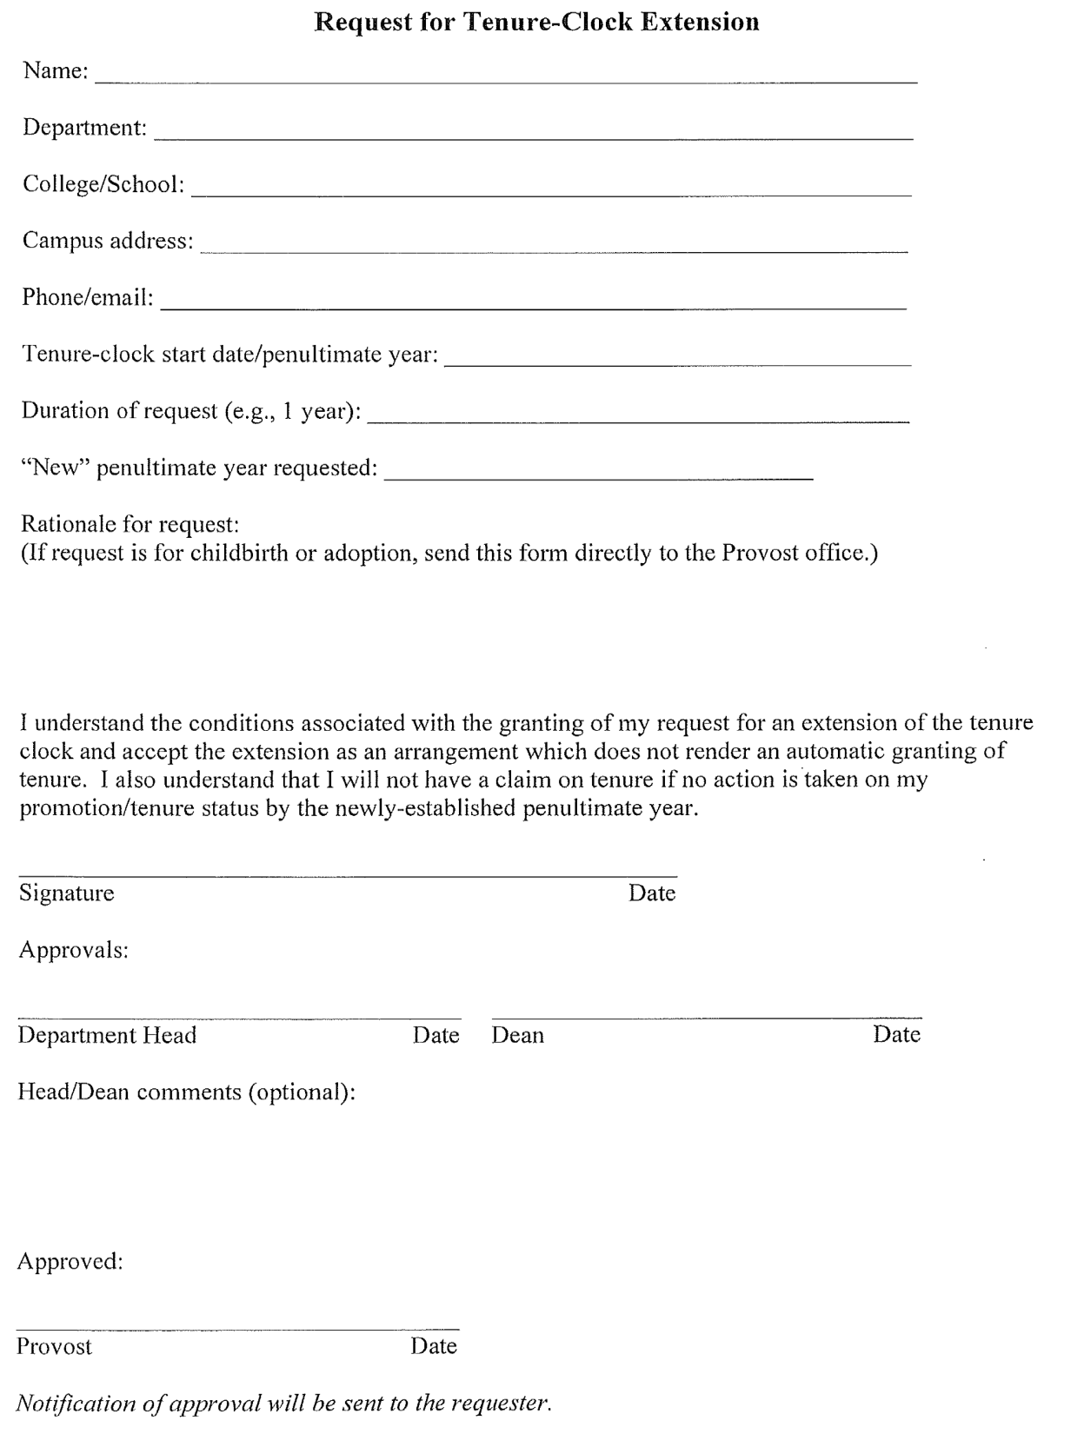

Slide 11
Please note that Dr. X received a one year interruption of his/her tenure clock by virtue of university policy. Under these circumstances, the criteria for promotion and tenure are no different than for faculty whose tenure clock has not been interrupted. We therefore request that this situation not be a factor in your letter of evaluation.

Slide 12
Men / women?
Opt in / opt out?

